Slide 1
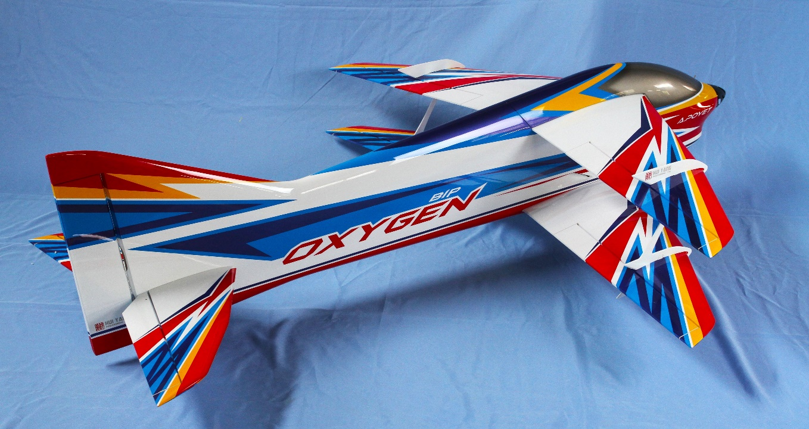
Flying and Judging F3A
F3A F-25 飞行与评分指南
SCHEMATIC MANOEUVRE ILLUSTRATIONS
SCHEDULE P-25

Slide 2
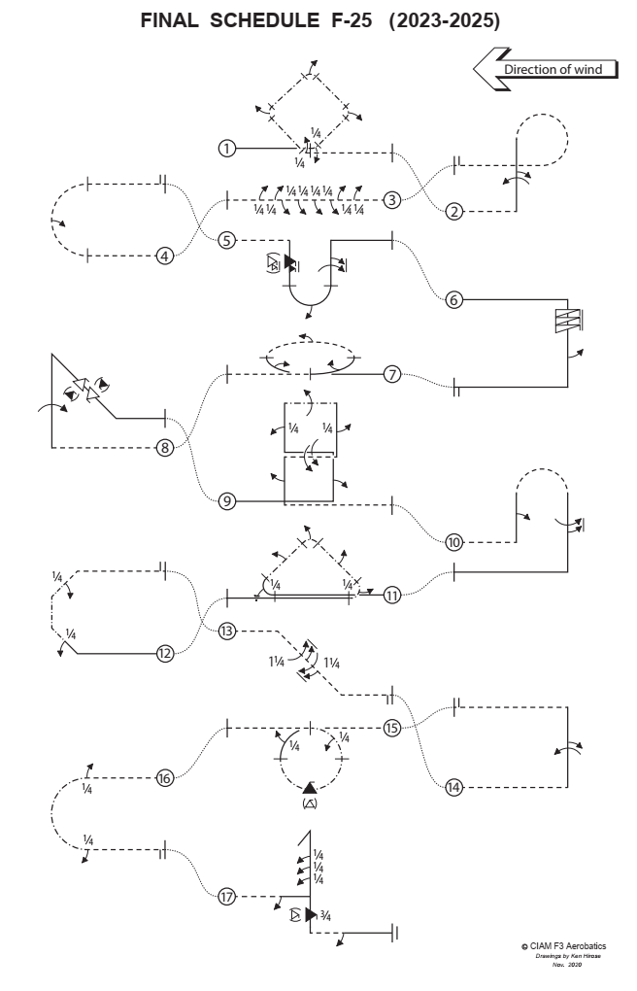
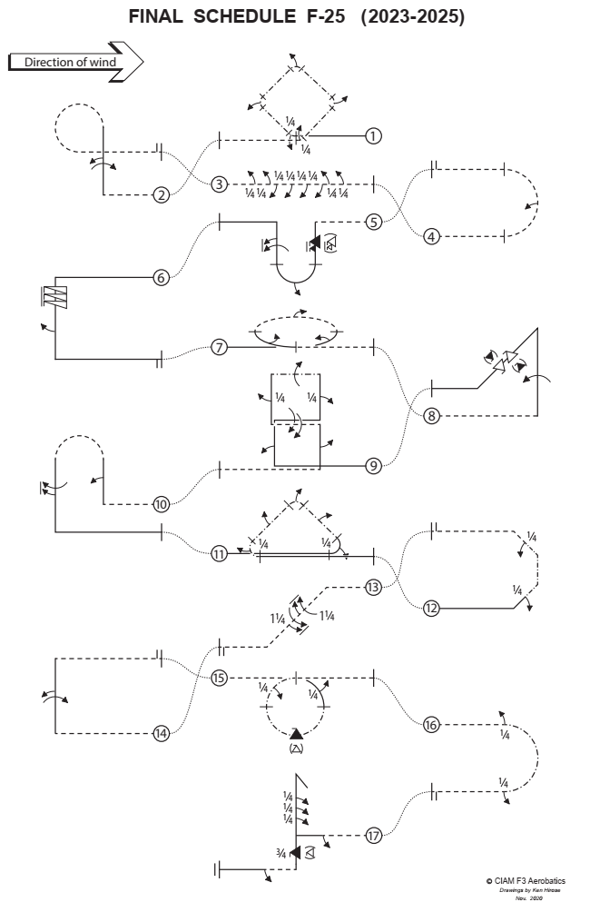

Slide 3
图形注释 Explanations:
正飞 Aircraft upright
倒飞 Aircraft inverted
正面向内的侧飞
Aircraft in Knife-Edge View from Top
背面向内的侧飞
Aircraft in Knife-Edge View from Below
位滚 part roll
半滚 half roll
横滚 roll
¼
正飞螺旋 pos. spin
倒飞螺旋 neg. spin
快滚 snap rolls
参考点 reference points
pos.
neg.

Slide 4
起飞程序
（不计分，不评分）
Take-off procedure
( not judged, not scored )
风向 wind
120⁰
安全线
Safety line

Slide 5
F-25.01 侧飞斜方筋斗转角同步滚
Square loop on Corner with quarter roll integrated, half roll integrated, half roll integrated, half roll integrated, quarter roll integrated
½ 同步滚
½ 同步滚
½ 同步滚
¼ 同步滚
¼ 同步滚
正飞进入，拉1/8圆弧同步做1/4滚，侧飞进入45°上升直线，做1/4侧飞筋斗同步做半滚，侧飞进入45°上升直线，做1/4侧飞筋斗同步做半滚，侧飞进入45°下降直线，
做1/4侧飞筋斗同步做半滚，侧飞进入45°下降直线，接1/8圆弧同步1/4滚，倒飞改出。
From upright, pull through a one eighth loop with quarter roll integrated into a forty-five degree knife-edge upline, perform a quarter knife-edge loop with half roll integrated into a forty five degree knife-edge upline, perform a quarter knife-edge loop with half roll integrated into a forty five degree knife-edge downline, perform a quarter knife-edge loop with half roll integrated into a forty five degree knife-edge downline, perform a one eighth knife-edge loop with quarter roll integrated, exit inverted.
F-25.01.01

Slide 6
F-25.01 侧飞斜方筋斗转角同步滚
Square loop on Corner with quarter roll integrated, half roll integrated, half roll integrated, half roll integrated, quarter roll integrated
½ 同步滚
45°侧飞直线，机翼必须保持与地面垂直
During the knife edge the wing must be in the vertical plane.
滚转必须与1/4圆弧的轨迹同步
Part rolls integrated on circular flightpath of the part loops.
½ 同步滚
½ 同步滚
¼ 同步滚
所有圆角半径相等
All radii are equal.
45°
¼ 同步滚
F-25.01.02

Slide 7
F-25.02 9字带双向组合滚
Figure Nine with roll, half roll in opposite direction
半滚
一周滚
倒飞进入，推1/4圆弧进入垂直上升直线，做一周滚，紧接着做反向半滚，推3/4圆弧，倒飞改出。
From inverted, push through a quarter loop into a vertical upline, perform consecutively a roll and a half roll in opposite direction, push through a three quarter loop, exit inverted.
F-25.02.01

Slide 8
F-25.02 9字带双向组合滚
Figure Nine with roll, half roll in opposite direction
一周滚和半滚组合位于直线段的中间
Roll and ½ roll centered on middle of the line.
一周滚和反向半滚之间不能有直线段
Between rolls and part rolls in opposite directions there must be no line.
所有圆角半径相等
All radii are equal.
F-25.02.02

Slide 9
F-25.03 八位双向1/4滚
Roll Combination with consecutive two quarter rolls, four consecutive quarter rolls in opposite direction, two consecutive quarter rolls in opposite direction
¼
¼
¼
¼
¼
¼
¼
¼
倒飞进入，连续做两个1/4位滚，紧接着反向连续做四个1/4位滚，紧接着再反向连续做两个1/4位滚，倒飞改出。
From inverted, perform consecutively two consecutive quarter rolls,
four consecutive quarter rolls in opposite direction, two consecutive quarter rolls in opposite direction, exit inverted.
F-25.03.01

Slide 10
F-25.03 八位双向1/4滚
Roll Combination with consecutive two quarter rolls, four consecutive quarter rolls in opposite direction, two consecutive quarter rolls in opposite direction
¼位滚之间的线段必须短且长度易于辨识。
Lines between part rolls must be short and of recognisable length.
¼
¼
¼
¼
¼
¼
¼
¼
反向滚之间不能有直线段。
Between part rolls in opposite direction there must be no line.
F-25.03.02

Slide 11
F-25.04 半筋斗同步半滚
Half Loop with half roll integrated
同步半滚
倒飞进入，推半筋斗并同步做半滚，倒飞改出。
From inverted, push through a half loop while integrating a half roll, exit inverted.
F-25.04.01

Slide 12
F-25.04 半筋斗同步半滚
Half Loop with half roll integrated
滚转速率必须保持恒定。
Roll rate must be constant.
半滚必须在半筋斗的飞行轨迹上同步完成。
½ roll must be integrated on circular flightpath of the half loop.
F-25.04.02

Slide 13
F-25.05 拉拉推倒驼峰带1-1/2快滚+横滚
Pull Pull Push Humpty Bump with one and half snap roll, half roll integrated, one and a half roll.
1 ½ 快滚
( )
1 ½ 横滚
½ roll integrated
倒飞进入，在中线前拉1/4圆弧进入垂直下降直线，做1-1/2快滚，拉1/2圆弧并同步做半滚，进入垂直上升直线，做连续1-1/2横滚，推1/4圆弧，正飞改出。
From inverted, before centre pull through a quarter loop into a vertical downline, perform one and a half snap roll, pull through a half loop with half roll integrated into a vertical upline, perform one and a half continuous roll, push through a quarter loop, exit upright.
F-25.05.01

Slide 14
F-25.05 拉拉推倒驼峰带1-1/2快滚+横滚
Pull Pull Push Humpty Bump with one and half snap roll, half roll integrated, one and a half roll.
进入和改出必须在相同高度
Entry and exit must be at the same altitude.
快滚和横滚在直线段的中间
Snap roll and roll on middle of the line.
( )
所有圆角半径相等
All radii are equal.
快滚可以是正向或者负向
Snap rolls may be positive or negative.
如果快滚 = 桶滚或者副翼滚，大幅扣分（＞5分）
If snap roll = barrel roll or aileron roll:
Severe downgrade > 5 pts.
半滚必须在半筋斗的飞行轨迹上同步完成。
½ roll must be integrated on circular flightpath of the half loop.
F-25.05.02

Slide 15
F-25.06 正飞螺旋三周带半滚
Three Turn Spin with half roll
半滚
正飞进入，连续做螺旋三周，保持一段垂直下降直线后做半滚，拉1/4圆弧，正飞改出。
From upright, perform a spin with three turns, perform a vertical downline, perform a half roll, pull through a quarter loop, exit upright.
F-25.06.01

Slide 16
F-25.06 倒飞螺旋带半滚
Three Turn Spin with half roll
快滚进入=0分 Snap entry - 0 points!
螺旋俯冲=0分 Spiral dive - 0 points!
强行进入：大幅扣分 Forced entry: downgrade.
螺旋后保持一段直线
Line after the spins.
半滚在直线段的中间
Half roll on middle of the line.
F-25.06.02

Slide 17
F-25.07 水平圆周带三个半滚
Horizontal Circle with three half rolls in opposite direction integrated
向外同步半滚
½ roll integrated to the outside
向内同步半滚
½ roll integrated to the inside
向内同步半滚
½ roll integrated to the inside
½ roll
正飞进入，做一个水平圆，在第一段90°圆弧上向内做同步半滚，紧接着在第二段180°圆弧上向外做同步半滚，紧接着在最后90°圆弧上再向内做同步半滚，倒飞改出。
（注：第一个同步半滚必须向内）
From upright, perform a horizontal circle with half roll integrated in the first ninety degrees, half roll in opposite direction integrated in next one hundred eighty degrees, half roll in opposite direction integrated in the last ninety degrees, exit inverted.
Note: First half roll is to the inside.
F-25.07.01

Slide 18
F-25.07 水平圆周带三个半滚
Horizontal Circle with three half rolls in opposite direction integrated
两个反向滚之间不能有停顿
Roll reversal must be immediate.
水平圆必须是固定的半径，
并且保持在相同的高度。
Circle must be of constant radius and must be flown at the same altitude.
飞机处于侧飞姿态
滚转速率必须保持恒定。
Roll rates must be constant.
飞机处于倒飞姿态
飞机处于正飞姿态
第一个同步半滚必须向内First ½ roll integrated must be inside.
半滚必须在水平圆的轨迹上同步完成。
The ½ rolls must be integrated on circular flightpath.
½ roll
F-25.07.02

Slide 19
F-25.08 鲨鱼鳍带一周滚+双向快滚
Shark Fin with roll, two snap rolls in opposite direction
双向快滚
Two snap rolls opposite
( )
一周滚
roll
( )
倒飞进入，推1/4圆弧进入垂直上升直线，做一周横滚，推3/8圆弧进入45°向下直线，做双向快滚各一周，拉1/8圆弧，正飞改出。
From inverted, push trough a quarter loop into a vertical upline, perform a roll, push through a three eighths loop into a forty-five degree downline, perform consecutively two snap rolls in opposite direction, pull through a one eighth loop, exit upright.
F-25.08.01

Slide 20
F-25.08 鲨鱼鳍带一周滚+双向快滚
Shark Fin with roll, two snap rolls in opposite direction
横滚和快滚位于直线段的中间
Roll and Snap rolls on middle of the line.
快滚可以是正向或者负向
Snap rolls may be positive or negative.
( )
两个快滚方向相反且中间没有直线段 Between snap rolls in opposite direction there must be no line.
( )
如果快滚=桶滚或者副翼滚
至少扣5分
If snap roll = barrel roll or aileron roll:
Severe downgrade > 5 pts.
45°
所有圆角半径相等
All radii are equal.
F-25.08.02

Slide 21
F-25.09 竖方8字
Square Vertical Eight with half roll, roll, quarter roll, roll, quarter roll, roll, half roll
一周滚
¼ 滚
¼ 滚
一周滚
一周滚
半滚
半滚
正飞进入，拉1/4圆弧进入垂直上升直线，做半滚，推1/4圆弧进入水平直线，做横滚一周，拉1/4圆弧进入垂直上升直线，作1/4位滚，向中心线做1/4侧飞筋斗进入侧飞水平直线，做横滚一周，做1/4侧飞筋斗进入垂直下降直线，做1/4位滚，推1/4圆弧进入倒飞直线，做横滚一周，拉1/4圆弧进入垂直下降直线，做半滚，推1/4圆弧，倒飞改出。
From upright, pull through a quarter loop into a vertical upline perform a half roll, push through a quarter loop, perform a roll, pull through a quarter loop into a vertical upline perform a quarter roll, perform a quarter knife edge loop (towards the center), perform a roll, perform a quarter knife-edge loop into a vertical downline, perform a quarter roll, push through a quarter loop, perform a roll, pull through a quarter loop into a vertical downline, perform a half roll, push through a quarter loop, exit inverted.
F-25.09.01

Slide 22
F-25.09 竖方8字
Square Vertical Eight with half roll, roll, quarter roll, roll, quarter roll, roll, half roll
侧飞直线，中间一周滚
¼
¼
所有圆角半径相等
All radii are equal.
所有滚转位于直线段的中间
All rolls on middle of the lines.
水平直线，中间一周滚
半滚
半滚
进入和改出必须在相同高度
Entry and exit must be at the same altitude.
F-25.09.02

Slide 23
F-25.10 推推拉驼峰
Push Push Pull Humpty Bump with half roll, one and a half roll.
½ roll
1 ½ roll
倒飞进入，推1/4圆弧进入垂直上升直线，做半滚，推1/2圆弧进入垂直下降直线，做连续1-1/2横滚，拉1/4圆弧，正飞改出。
From inverted, push through quarter loop into a vertical upline, perform a half roll, push through a half loop into a vertical downline, perform one and a half continuous rolls, pull through quarter loop, exit upright.
F-25.10.01

Slide 24
F-25.10 推推拉驼峰
Push Push Pull Humpty Bump with half roll, one and a half roll.
所有滚转位于直线段的中间
All rolls on middle of the lines.
所有圆角半径相等
All radii are equal.
F-25.10.02

Slide 25
F-25.11 侧飞三角筋斗
Knife-Edge Triangle with quarter roll integrated, half roll, half roll integrated, half roll, quarter roll integrated
同步半滚
½ roll integrated
45°侧飞直线，中间半滚
45°侧飞直线，中间半滚
¼ 同步滚
¼ 同步滚
正飞进入，飞过中线后拉3/8圆弧并同步做1/4滚，进入45°上升侧飞直线，做半滚，顶端做1/4侧飞筋斗并同步做半滚，进入45°下降侧飞直线，做半滚，接3/8圆弧并同步做1/4滚，正飞改出。
From upright, fly past center pull through a three eighths loop with quarter roll integrated into a forty-five degree knife-edge upline, perform a half roll, perform a quarter knife-edge loop with a half roll integrated into a forty-five degree knife-edge downline, perform a half roll, perform a three eighths knife-edge loop with a quarter roll integrated, exit upright.
F-25.11.01

Slide 26
F-25.11 侧飞三角筋斗
Knife-Edge Triangle with quarter roll integrated, half roll, half roll integrated, half roll, quarter roll integrated
同步半滚
½ roll integrated
半滚在直线段的中间
Half roll on middle of the line.
45°侧飞直线，
机翼必须保持与地面垂直
During knife edge the wing must be in the vertical plane.
半滚
半滚
转角处的滚转在圆弧轨迹上同步完成
Part rolls integrated on circular flightpath of the part loops.
所有圆角半径相等
All radii are equal.
45°
¼ 同步滚
¼ 同步滚
F-25.11.02

Slide 27
F-25.12 半八边筋斗带侧飞组合带1/4滚
Half Eight Sided Loop with quarter roll, quarter roll
¼ 滚
¼ 滚
正飞进入，拉1/8圆弧进入45°上升直线，做1/4位滚进入侧飞，做1/8侧飞圆弧进入垂直上升直线，做1/8侧飞圆弧进入45° 上升侧飞直线，做1/4位滚，拉1/8圆弧，倒飞改出。
From upright, pull through a one eighth loop into a forty-five degree upline, perform a quarter roll, perform a one eighth knife-edge loop into a vertical upline, perform a one eighth knife-edge loop into a forty-five degree knife-edge upline, perform a quarter roll, pull through a one eighth loop, exit inverted.
F-25.12.01

Slide 28
F-25.12 半八边筋斗带侧飞组合带1/4滚
Half Eight Sided Loop with quarter roll, quarter roll
¼滚位于直线段的中间
¼ rolls on middle of the line.
¼
侧飞直线，
机翼必须保持与地面垂直
During knife edge the wing must be in the vertical plane.
所有圆角半径相等
All radii are equal.
45°直线段和垂直直线段等长
45° lines and vertical line must be of equal length.
¼
F-25.12.02

Slide 29
F-25.13 45°下降双向1-1/4滚
Forty Five Degree Downline with two consecutive one and a quarter rolls in opposite direction.
1 ¼ roll
1 ¼ roll
倒飞进入，拉1/8圆弧进入45°下降直线，做连续的1-1/4横滚紧接着做反向1-1/4横滚，推1/8圆弧，倒飞改出。
From inverted, pull through a one eighth loop into a forty five degree downline, perform consecutively two one and a quarter rolls in opposite direction, push through a one eighth loop, exit inverted.
F-25.13.01

Slide 30
F-25.13 45°下降双向1-1/4快滚
Forty Five Degree Downline with two consecutive one and a quarter rolls in opposite direction.
双向滚转组合位于直线段中间
Rolls centered on middle of the line.
1 ¼
双向滚之间不能有直线段Between rolls in opposite direction there must be no line.
所有圆角半径相等
All radii are equal.
1 ¼
45°
F-25.13.02

Slide 31
F-25.14 半方筋斗带横滚+反向半滚
Half Square Loop with roll, half roll in opposite direction
半滚
一周滚
倒飞进入，推1/4圆弧进入垂直上升直线，先做一周滚，紧接着反向做半滚，拉1/4圆弧，倒飞改出。
From inverted, push through a quarter loop into a vertical upline, perform consecutively a roll and a half roll in opposite direction, pull through a quarter loop, exit inverted.
F-25.14.01

Slide 32
F-25.14 半方筋斗带横滚+反向半滚
Half Square Loop with roll, half roll in opposite direction
滚转组合位于直线段的中间
Rolls centered on middle of the line.
一周滚和反向半滚之间不能有直线段
Between rolls and part rolls in opposite direction there must be no line.
所有圆角半径相等
All radii are equal.
F-25.14.02

Slide 33
F-25.15 雪崩带1/4同步滚+快滚
Avalanche (from top) with quarter roll integrated, snap roll, quarter roll integrated
¼ 同步滚
¼ 同步滚
侧飞快滚
( )
倒飞进入，做一个筋斗，在筋斗的第一段90°圆弧上同步做1/4滚进入侧飞，
在筋斗底部做快滚一周，在筋斗的最后一段90°圆弧上同步做1/4滚，倒飞改出。
From inverted, pull through a loop, perform a quarter roll integrated in the first ninety degrees of the loop, perform a snap roll at the bottom of the loop, perform a quarter roll integrated in last ninety degrees of the loop, exit inverted.
F-25.15.01

Slide 34
F-25.15 雪崩带1/4同步滚+快滚
Avalanche (from top) with quarter roll integrated, snap roll, quarter roll integrated
筋斗必须是正圆
Loop must be round.
¼ 同步滚
¼ 同步滚
¼滚必须与90°圆弧同步完成
The ¼ roll must be integrated on circular flightpath of the first 90° of the loop.
¼滚必须与90°圆弧同步完成
The ¼ roll must be integrated on circular flightpath of the first 90° of the loop.
如果快滚=桶滚或者副翼滚
至少扣5分
If snap roll = barrel roll or aileron roll:
Severe downgrade > 5 pts.
( )
快滚可以是正向或者负向
Snap rolls may be positive or negative.
F-25.15.02

Slide 35
F-25.16 侧飞半筋斗
Knife Edge Split S with quarter roll, quarter roll
¼ roll
¼ roll
倒飞进入，做1/4滚，紧接着向下做侧飞半筋斗接1/4滚，倒飞改出。
From inverted, perform a quarter roll, immediately perform a half knife-edge loop down, immediately perform a quarter roll, exit inverted.
F-25.16.01

Slide 36
F-25.16 侧飞半筋斗
Knife Edge Split S with quarter roll, quarter roll
侧飞半筋斗必须紧接在1/4滚后开始，
第二个1/4滚必须紧接在侧飞半筋斗之后The half knife-edge loop starts immediately after the ¼ roll, the second ¼ roll starts immediately after the half knife-edge loop.
侧飞筋斗过程中，
机翼必须保持与地面垂直During knife edge the wing must be in the vertical plane.
¼
F-25.16.02

Slide 37
F-25.17 失速倒转带3/4位滚+快滚
Stall Turn with half roll, three quarter rolls, three quarter snap roll, half roll
¼
¼
( )
¾ 快滚
¼
半滚
半滚
倒飞进入，做半滚并保持一段直线，拉1/4圆弧进入垂直上升直线，连续做三个1/4位滚，做失速倒转进入垂直下降直线，做3/4快滚，推1/4圆弧进入倒飞并保持一段直线，然后做半滚，正飞改出。
注：整个动作在最后一个半滚完成并保持一段直线后结束。
From inverted, perform a half roll, pull through a quarter loop into a vertical upline, perform three consecutive quarter rolls, perform a stall turn into a vertical downline, perform a three quarter snap roll, push through a quarter loop, perform a half roll, exit upright.
Note: Exit starts after the last half roll.
F-25.17.01

Slide 38
F-25.17 失速倒转带3/4位滚+快滚
Stall Turn with half roll, three quarter rolls, three quarter snap roll, half roll
倒转前有短暂停顿Stop before pivot
(slight hesitation)
围绕重心倒转Pivot on CG
偏移幅度大于等于两倍翼展 = 0分Two wing spans or more – zero points!
¼位滚组合位于直线段中间 ¼ rolls centered on middle of the line.
¾快滚位于直线段中间
¾ snap roll on middle of the line.
¼
¼
( )
¾
¼位滚之间的线段必须短且长度易于辨识。
Lines between part rolls must be short and of recognisable length.
¼
所有圆角半径相等
All radii are equal.
直线段line
直线段line
F-25.17.02

Slide 39
着陆程序
（不计分，不评分）
Landing procedure
( not judged, not scored )
风向
着陆方向可以与起飞方向不同。
The direction of the landing may be different to the take off.
120⁰
安全线
Safety line

Slide 40
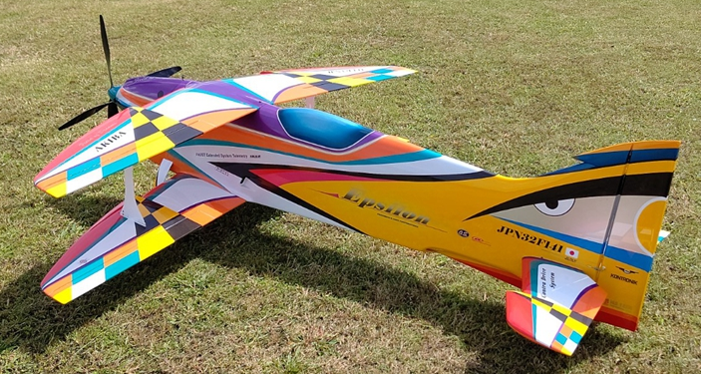
忘记谁在飞
（朋友，竞争对手，同胞，来自其他国家的选手）
忘记什么在飞
（2冲程，4冲程，电动）
只看飞机在天空中描绘的轨迹！
Forget WHO is flying
(friend, rival, countryman, flier from other nation)
Forget WHAT is flying
(2-stroke, 4-stroke, electric)
LOOK ONLY AT LINES DESCRIBED IN THE SKY!
Bob Skinner
谢谢观看！
© Peter Uhlig, February 2023
翻译：Hui Yang F3A 校对：刘爱强 2023年10月

